Slide 1
Graphical Perception in Data Visualization

Slide 2

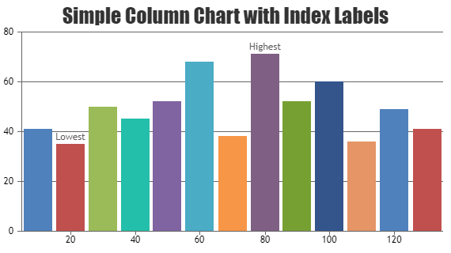
Data Visualization?

Slide 3
Key point
Data
Data

Slide 4
Key point
A
B

Slide 5
Key point
A
B

Slide 6
Key point
A
B

Slide 7
Key point
A
B

Slide 8
Key point
A
B

Slide 9
Just Noticeable Difference

Slide 10
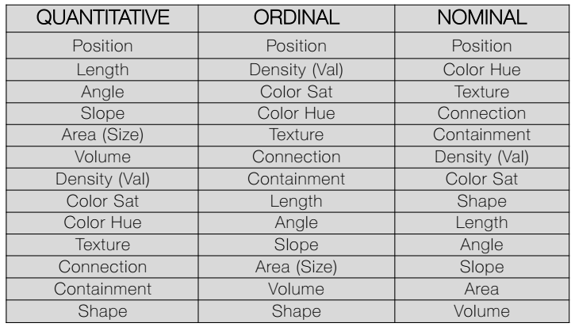
JND

Slide 11
JND

Slide 12


Slide 13
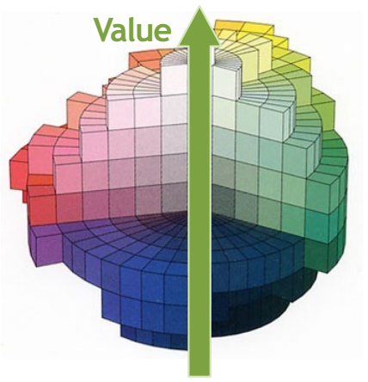

Slide 14
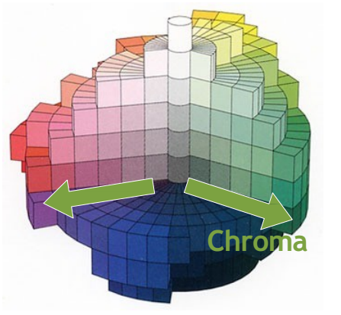

Slide 15
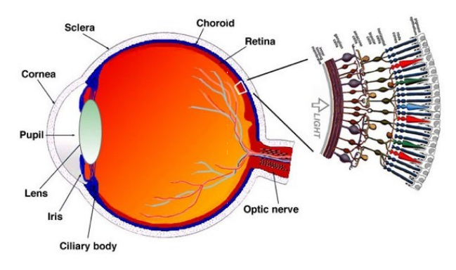

Slide 16
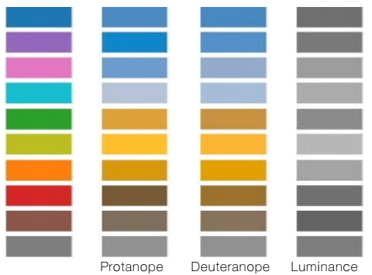

Slide 17
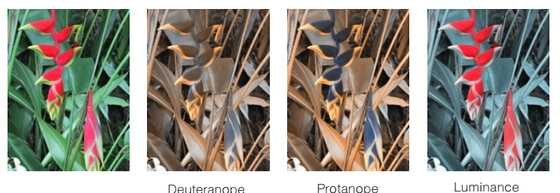

Slide 18
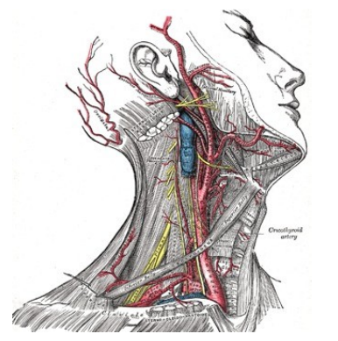
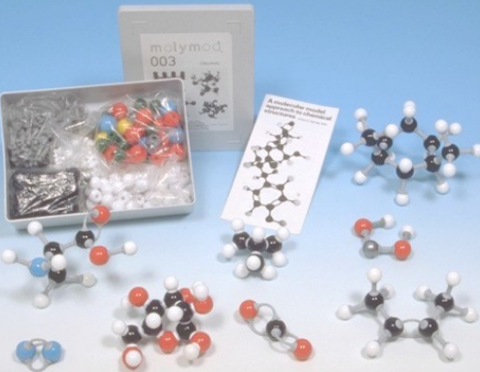

Slide 19
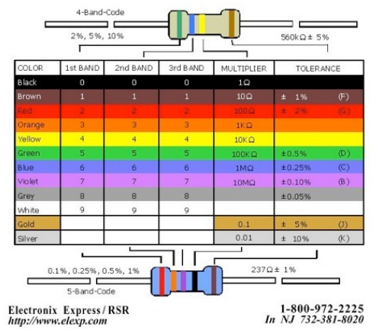

Slide 20
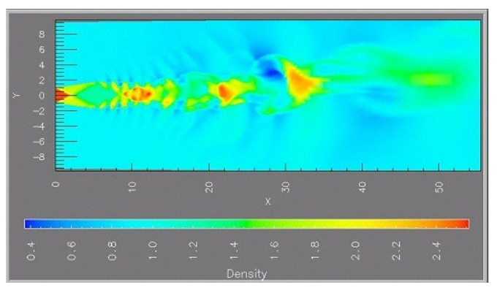

Slide 21
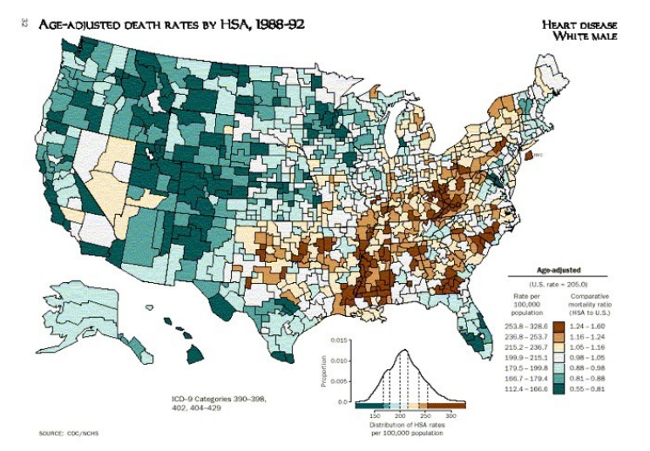

Slide 22
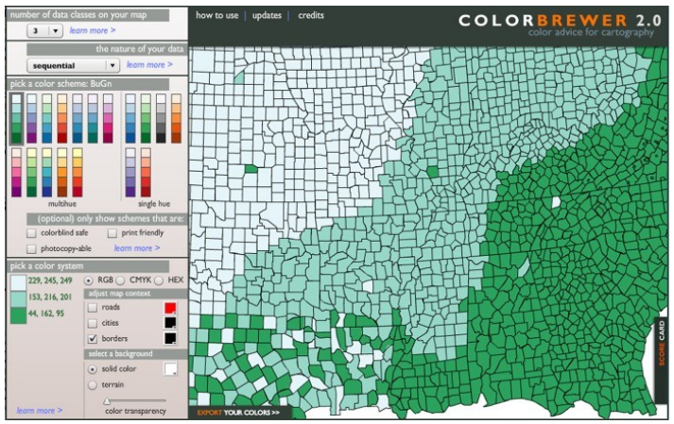
https://colorbrewer2.org/#type=sequential&scheme=BuGn&n=3

Slide 23
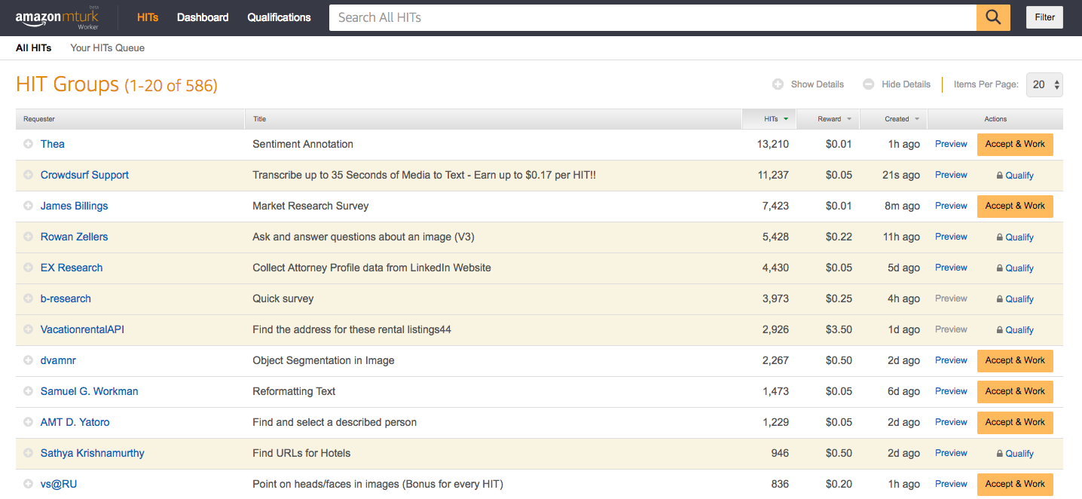
Mechanical truk

Slide 24
Thanks

